Slide 1
TOPIC: PREPARATION OF REAGENTS FOR FOOD ANALYSIS
Dr. K. MAHMOODAH PARVEEN
ASSISTANT PROFESSOR
PG & RESEARCH DEPARTMENT OF CHEMISTRY
JAMAL MOHAMED COLLEGE
TRICHY-20

Slide 2
Dichlorophenol Indophenol for Vitamin C
2,6-dichlorophenolindophenol (DCPIP) can be used to estimate the concentration of vitamin C in food.
DCPIP is blue when dissolved in water, is red in acid conditions, and is reduced by ascorbic acid (vitamin C) ) to a colourless compound.

Slide 3
Other names of Dichloroindophenol
2,6-Dichlorophenolindophenol
2,6-Dichloroindophenol
2,6-Dichloro-4-[(4-hydroxyphenyl)imino]-2,5-cyclohexadien-1-one

Slide 4
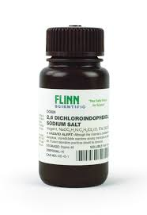

Slide 5
PREPARATION
indophenol solution is prepared by mixing 0.5 g of indophenol powder with 1 cup of water.
2,6-Dichloroindophenol, or indophenol, is a vitamin C indicator.

Slide 6
PRINCIPLE OF THIS METHOD
The principle of this method is a titration with dichlorophenolindophenol (or phenol-indo-2:6-dichlorophenol, also known as DCPIP).
Ascorbic acid reacts with DCPIP, changing the colour from blue to colourless.

Slide 8
USES OF DCPIP
DCPIP can be used to measure the rate of photosynthesis. It is part of the Hill reagents family.
DCPIP can also be used as an indicator for vitamin C. If vitamin C, which is a good reducing agent, is present, the blue dye, which turns pink in acid conditions, is reduced to a colorless compound by ascorbic acid.
DCPIP can be used to measure the rate of photosynthesis.

Slide 9
MOLISCHE REAGENTS
Molisch’s test is a chemical test which is used to check for the presence of carbohydrates in a given analyte.
Molisch's reagent (uncountable) (chemistry) α-naphthol (C₁₀H₈OH) dissolved in ethanol (C₂H₅OH). It is used in Molisch's test for the detection of carbohydrates.

Slide 10
PREPARATION
The test solution is combined with a small amount of Molisch's reagent (α-naphthol dissolved in ethanol) in a test tube. After mixing, a small amount of concentrated sulfuric acid is slowly added down the sides of the sloping test-tube, without mixing, to form a layer.

Slide 11
PRINCIPLE OF MOLISCH’S TEST
Molisch's test is a sensitive chemical test, named after Austrian botanist Hans Molisch, for the presence of carbohydrates, based on the dehydration of the carbohydrate by sulfuric acid or hydrochloric acid to produce an aldehyde, which condenses with two molecules of a phenol (usually α-naphthol, though other phenols .

Slide 12
Molisch test is a chemical test to detect carbohydrates. Carbohydrates undergo dehydration when heated with concentrated H₂SO₄ to form furfural derivatives. Furfural derivatives so obtained are condensed with alpha naphthol to give coloured compounds and hence presence of carbohydrate is confirmed.

Slide 14
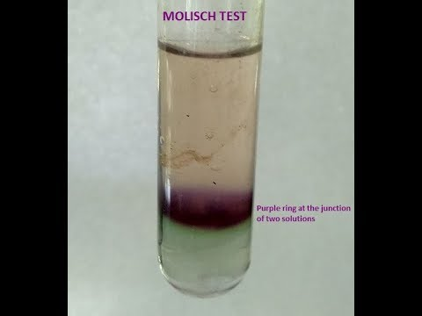

Slide 16
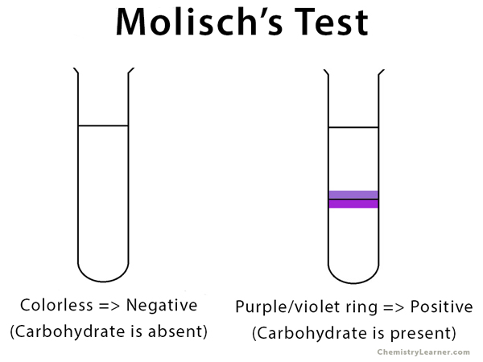

Slide 17
USES OF MOLISCH’S TEST
Molisch's test is a chemical test which is used to check for the presence of carbohydrates in a given analyte. This test is named after Czech-Austrian botanist Hans Molisch, who is credited with its discovery.

Slide 18
FEHLING’S REAGENT A & B
A blue solution of Rochelle salt and copper sulfate used as an oxidizing agent in a test for sugars and aldehydes in which the precipitation of a red oxide of copper indicates a positive result.
Fehling's solution is prepared by combining two separate solutions: Fehling's A, which is a deep blue aqueous solution of copper(II) sulfate, and Fehling's B, which is a colorless solution of aqueous potassium sodium tartrate (also known as Rochelle salt) made strongly alkali with potassium hydroxide.

Slide 19
PREPARATION OF FEHLING’S SOLUTION
Fehling's "A" uses 7 g CuSO₄. 5H₂O dissolved in distilled water containing 2 drops of dilute sulfuric acid.
Fehling's "B" uses 35g of potassium tartrate and 12g of NaOH in 100 ml of distilled water.
These two solutions should be stoppered and stored until needed.

Slide 20
PRINCIPLE OF FEHLING TEST
The principle of the Fehling test is based on the fact that the aldehyde group of sugar is oxidised by complex copper ions to form acid.
The red copper (I) oxide then precipitates, which is an indicator for the redox reaction. Sugars can exist in aqueous solution as a ring shape or as an open chain molecule.

Slide 21
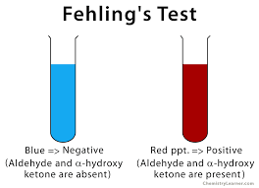

Slide 22
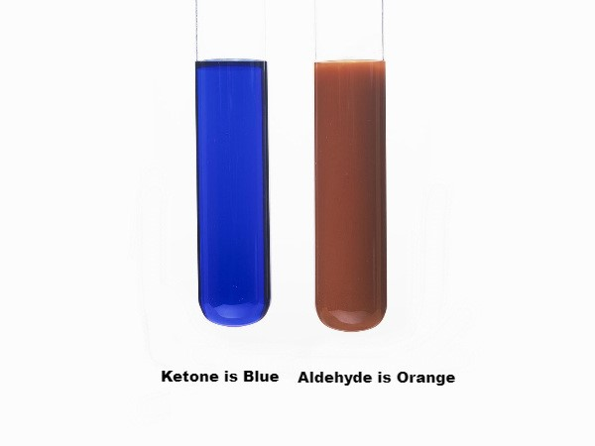

Slide 23
USES OF FEHLING’S TEST
Fehling’s solution is used to distinguish between aldehyde and ketone functional groups. Aldehydes oxidize to give a positive result.
In medicine, Fehling’s solution is used to detect glucose in urine as a part of detecting diabetes.
Fehling's solution. Fehling's solution is a chemical reagent used to differentiate between water-soluble carbohydrate and ketone functional groups, and as a test for reducing sugars and non-reducing sugars.

Slide 24
THANK YOU !

